Slide 1
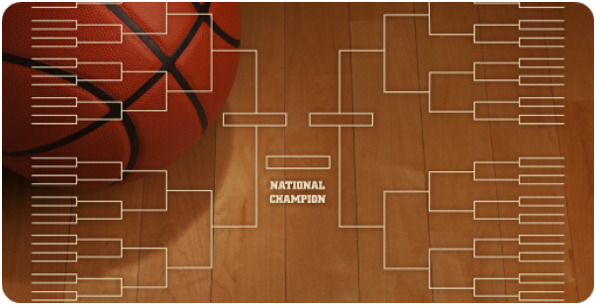








NCAA Basketball Tourney
Customizable Package Slide
Many of these sections are modular. Please use this as your canvas to build a campaign package to fit your market or client needs, while maintaining the brand integrity and aesthetics.
Change Title (if necessary).
Edit/Add Key Dates.
Edit/Add Network Logos.
Add Your Client Goals (this section can be expanded or moved).
Add Campaign Package Details and/or Summary for “In-Telecast”, “Multiscreen”, “Traditional TV”, or other…
Don’t need so much space for your package? Check out the other Template on MSR’s Programming Page.
Remove Client Signature Line (if unnecessary).
Quality Control: From a brand perspective, please keep font, font size, font colors, aesthetics, and spacing consistent with the rest of the slide.
Delete this Box before presenting or sending to client. Best practice would be to create as a PDF instead of sending as a PPT.
03/15/26 Selection Sunday
03/17-03/28 Men’s Play-In + Rounds 1-4
03/18-03/30 Women’s Play-In + Rds 1-4
04/03-04/05 Women’s Semis + Champ
04/04-04/06 Men’s Semis + Championship
Schedule subject to change. Network insertion may vary by market and is based on inventory availability.

